Slide 1
Drama Objectives: Stage Spaces 11.4.13
Behavior: Students will discover where the 9 different stage areas are a theater stage.
Conditions: Students will view Staging Powerpoint and participate in Flash matching games.
Criteria: After Powerpoint/activity, all students will be able to identify at least 6/9 stage spaces on the Stage Space Worksheet.

Slide 2
Do Now Do Now
2.6.14
“How Did I Succeed” Letter

Slide 3
Do Now
Get out your black portfolio binders and make the following diagram on a new page.

Slide 4
STAGE DIRECTIONS

Slide 5
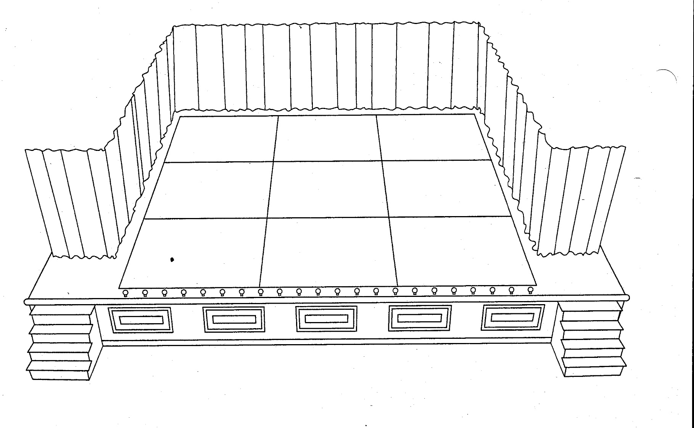
Stage Areas
9 basic areas
Stage directions are from the actors point-of-view, facing the audience.

Slide 6
Stage Areas
C = Center
C

Slide 7

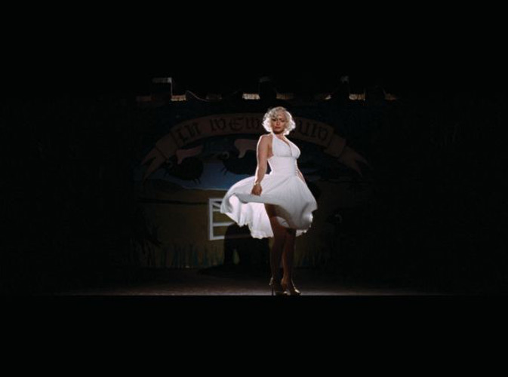
Center Stage (C)
is primarily a position of great importance or prominence.

Slide 8
Stage Areas
D = Down/Downstage
C
D
D
D

Slide 9
The down stage position is located DOWN by the audience.

Slide 10

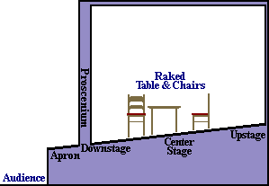
Towards the FRONT on the stage.

Slide 11
Stage Areas
U = Up/Upstage
U
U
U
C
D
D
D

Slide 12
The upstage position is located near the backstage area.
Upstage is close to the back curtain!

Slide 13
Furthest away from the audience.
Upstage

Slide 14
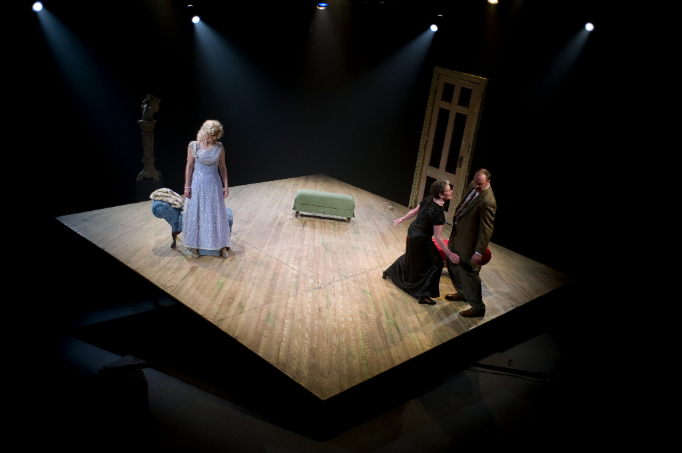
Raked Stage
Sloped upwards away from the audience.
This improves the view for the audience.
Led to the theatre positions "upstage" and "downstage", meaning, respectively, farther from or closer to the audience.

Slide 15
Stage Areas
R = Right/Stage Right
UR
U
U
CR
C
DR
D
D

Slide 16
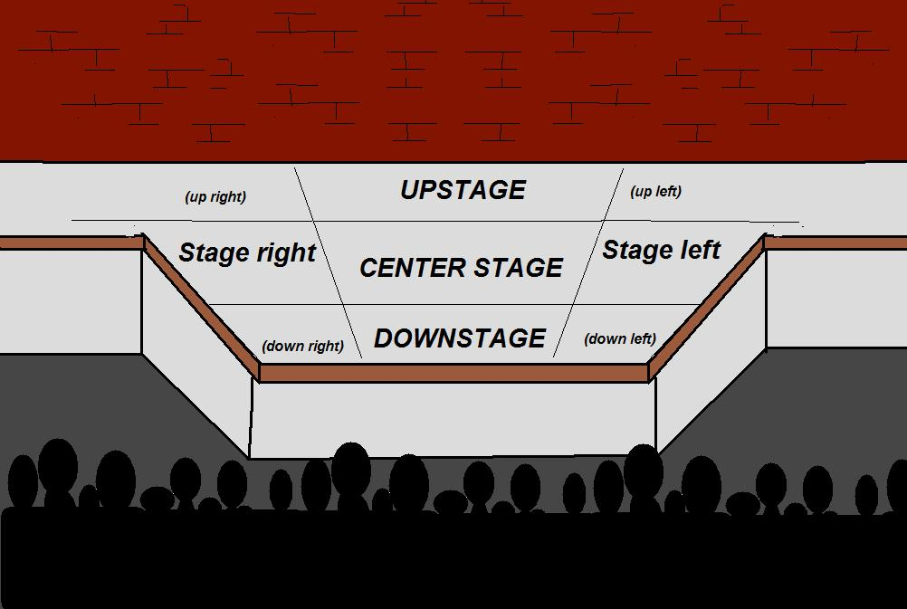
Stage Directions are seen from the ACTOR’s Perspective

Slide 17
Stage Areas
L = Left/Stage Left
UR
U
UL
CR
C
CL
DR
D
DL

Slide 18
How can actors and directors utilize this knowledge of the stage space?

Slide 19
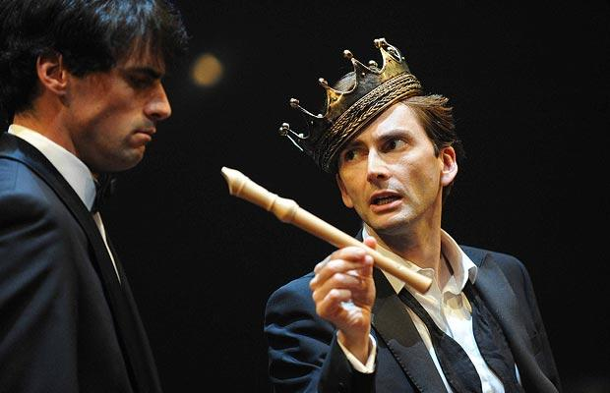
Blocking
Precise and planned movement of actors on stage
  Always taken from the actors perspective

Slide 20
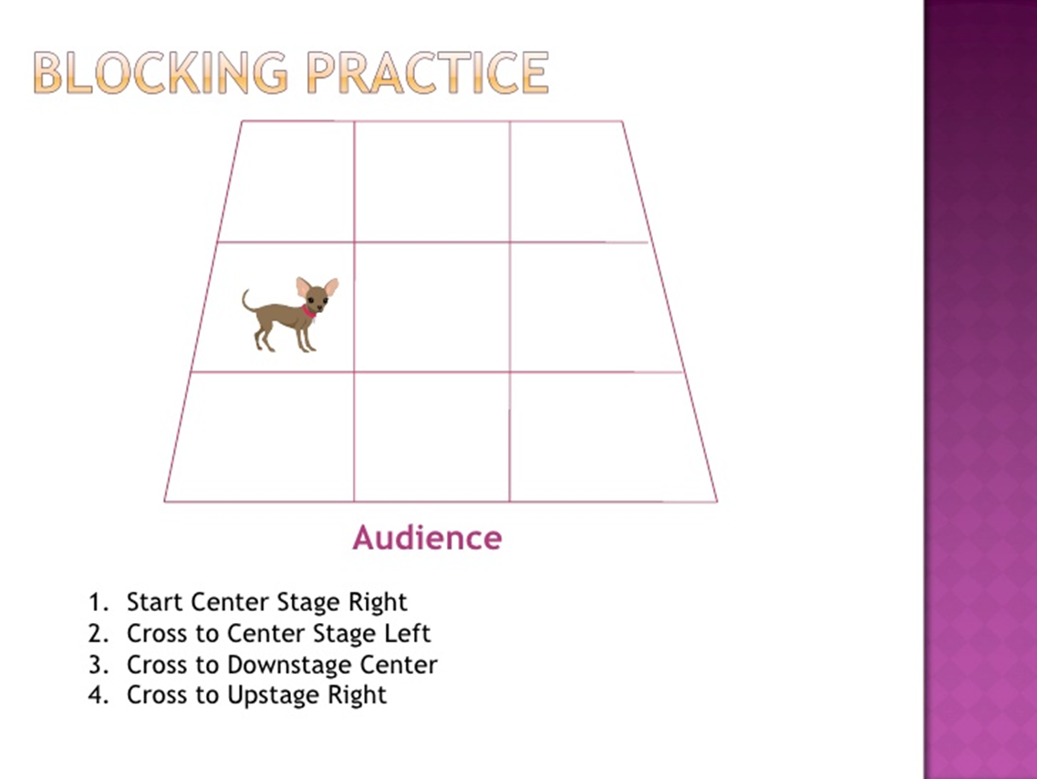

Slide 21
Flash Game
Stage Directions

Slide 22
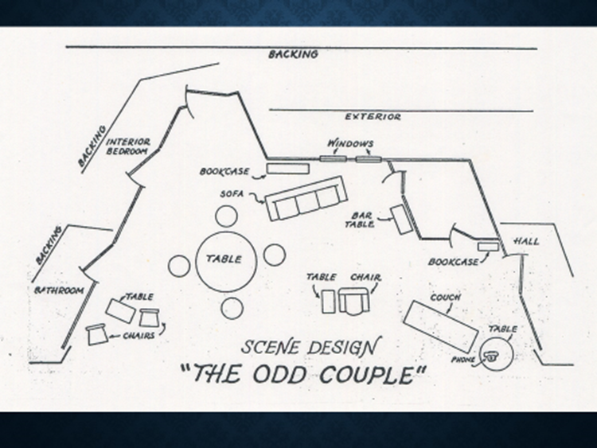

Slide 23
Minefield

Slide 24
Flash Game
Stage Directions

Slide 25
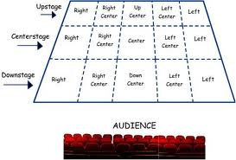
Stage Diagramming

Slide 26
Set Diagramming
A door opening into a bathroom far RC
2 doors opening into a bedroom far UR
A small rectangular table DR with 2 chairs R and L of it
A large round table surrounded by 4 stools RC
A sofa UC
A bookcase far UC, set against the wall
2 windows, far UC, L of bookcase
Padded chair CL with rectangular side table to its R
Bar table _____________________
Door________, U of ________________.
Bookcase far __________________, set against__________
Couch_____________________, with ____________________________ to its __________.

Slide 27
Assignment
Tips for diagramming:
  Use a ruler/straight edge and a PENCIL.
  Use 4 squares per meter (roughly 1 square per foot)
Grading criteria:
  Clarity and readability of labelling.
  Cleanliness and clarity of drawing.
  Correct placement of furniture and architecture.
  DUE FEB 8th WRITE THIS IN YOUR PLANNER
Diagram the Drama room. (the drama room is roughly 56 feet long and 24 feet wide)
Diagram the following set with:
  Three walls. In the U back wall there is one large window far L.
  In the L wall are two doors. The D door opens out into the kitchen. The U door opens onto the stage revealing a small closet.
  Against the R wall at CR is a bookcase.
  In the R wall, D of the bookcase is a door opening out into a garden.
  A long rectangular table CR with four chairs along the U side , one chair at the L end of the table, and one chair at the R end.
  A desk DL with a chair at it, facing L and another chair U of the desk facing R.
  A sofa far UR

Slide 28
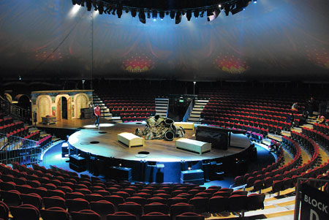
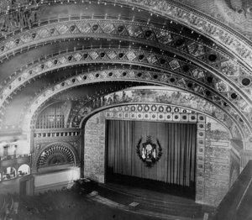
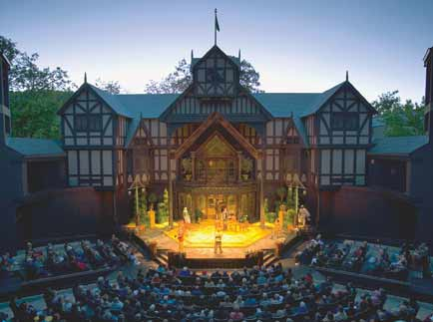
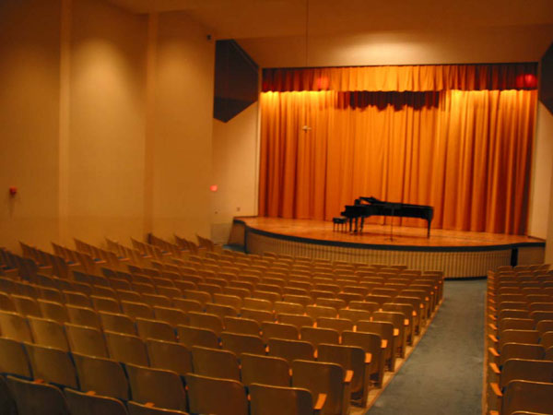
Types of Stages
Proscenium or Picture Frame
Arena
or
Theater in the Round
End Stage
or Concert Hall
Thrust or Elizabethan

Slide 29

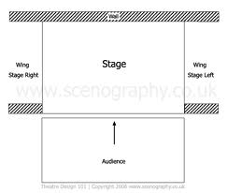
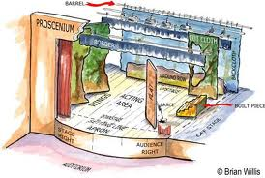
Proscenium

Slide 30
Proscenium
The most common style of staging.
Traditionally the playing space is hidden by a curtain.
The farthest downstage plane is where the imaginary 4th wall is.
  4th wall: The opening into the world of the play. If you imagine playing space as a room with 4 walls, 3 of them are visible, but one is invisible, allowing the audience to witness the action of the play.

Slide 31
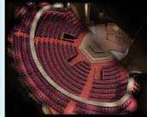
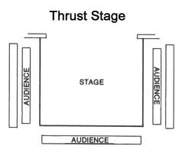
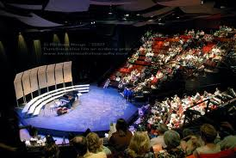
Thrust

Slide 32
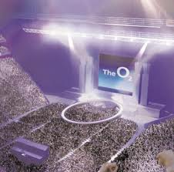
Thrust staging
What does thrust staging require of the actors?
  If playing on the thrust, actors must remember to turn toward various parts of the audience during the course of a scene.
  In vocal terms, the actor must project more when on the thrust, as there is little acoustic help from the architecture of the auditorium.

Slide 33
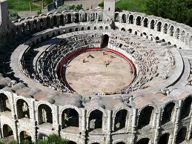
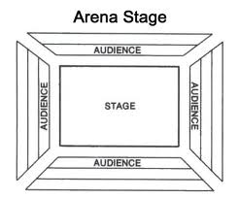
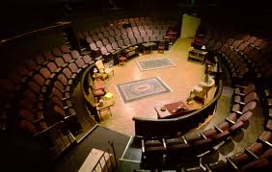
ARENA

Slide 34
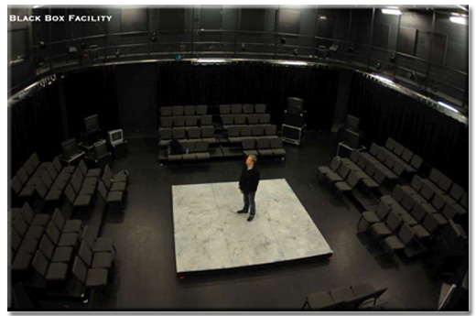
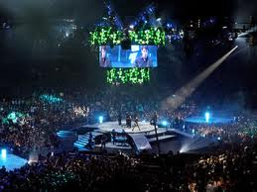
Arena staging
The playing space is surrounded on all sides by the audience.
Entrances often consist of aisles through the audience.
Used to give the audience a sense of intimacy/close connection with the production.

